Slide 1
Anatomies of a Test Plan & Test Cases
Medi Servat
INFO6255 – Quality Management
NU
2019

Slide 2
What is a Test Plan?
A Test Plan describes the testing scope and the approach.
Defines the objectives of the testing clearly.
It summarizes the testing scope and specifies all aspects of the testing including the testing roadmap.
It sets the conditions for testing by defining the testing activities and the testing dependencies.
It identifies the tools, the resources, the timelines, the risks and the entrance/exit criteria for testing.
The Test Plan is a testing contract that will have to be reviewed and approved by all of the project stake holders.

Slide 3
What is a Test Plan?
The Test Plan goes through many iterations before completion.
The Test Plan starts early in the project and gets completed before the testing starts.
There are many different test plan formats. The Test Plan outline should be flexible and should fit the project.
The test plan reviews allow more fact findings and yields great results.
The test plan should be clear, concise and to the point.
The test plan is one of the important testing artifacts.

Slide 4
Test Plan
Test Plan/ Test Strategy is a document that outlines the
Scope of testing
Testing Objectives
Testing Schedules
Roles and Responsibilities
Testing Phases
Features to be Tested (in scope)
Features not to be tested (out of scope)
QA Entrance Criteria
QA Exist Criteria
Dependencies
Test Environments
Risks & Assumptions
Defect Severities/Processes
Developed by the QA or the Lead QA, reviewed by all members on the project team. Approved by the managers.

Slide 5
Document Version Control & Appendices
The Test Plan document should have version numbers, Author, and dates associated with the last updates to the document
References to Test Case documentations must exist in the appendices
Include any user roles list, and technical details information in the Appendices as well

Slide 6
Test Plan Sections
Scope of Testing:
This will be a high level description of what will be covered in the testing. It also includes the functions that will be tested and the areas that will not be tested.
Testing Objectives:
This will include the goals and the objectives of the testing. It helps the QA manager and the testers to focus on the areas that are needed for testing.
Testing Schedules:
This section confirms the testing schedules for all of the subset of testing. E.g Functional, Integrations, End to End, Performance, and UAT timelines.

Slide 7
Test Plan Sections
Roles and Responsibilities:
It is important to specify who is responsible for which aspect of testing and the support associated with the testing.
Testing Phases:
Re-iterate the testing phases and the timelines associated with the entire testing life cycle.
Show the sequence of testing and the dependency with other projects.
State the requirements for Performance and load testing and the required SLAs.
In Scope/Out of Scope:
Specify the features that will be part of testing and the features that will not be in the scope of testing. Explain the reasoning why for both.

Slide 8
Test Plan Sections
QA Entrance/Exit Criteria:
Each phase of testing should have an entrance and exit criteria to ensure that the objectives are met before the start or ending each phase of the testing.
A complete Code Freeze prior to start of Functional Testing (Entrance Criteria)
No Open major defects open upon completion of the End to End testing (Exit Criteria)
Dependencies:
State any testing dependencies to any external systems, or any other test equipment, or resources in other groups creating input/output data for the testing.
Risks and Assumptions:
Enter any risks that could jeopardize the time lines or any assumptions that is taken into considerations during the testing.
It includes any assumptions about the testing or the development resources, testing tools and/or the downstream test environments availability.

Slide 9
Test Plan Sections
Test Environment:
State any hardware requirements or any peripheral test equipment needed in the test environment.
State any requirements for the test configuration or any particular test data needed for testing.
State the Release Management process during testing and how each release should get deployed in QA for testing.
Defect Tracking Guidelines:
Re-iterate the Defect Tracking processes and the Defect Severities.
Responsibilities of the Development, Test Lead and QA in regards to the defect management.

Slide 10
Test Scenarios vs Test Cases
A Test Scenario is a high level description of the Test Case(s).
It covers a wide range of possibilities
It is a high level description of the test area
There are One to One or One to Many relationships (One Test Scenario to Many Test Cases)
Example:
Test Scenario: Check the Login Functionality to Google.Com
Test Cases:
Test Case 1: Check for Valid user id and password (Positive Test Case)
Test Case 2: Check for invalid user id and password (Negative Test Case)
Test Case 3: Check for Null values for User id and Password (Negative Test Case)

Slide 11
Relationship of the Test Scenarios with Test Cases
One test Scenario maps to one or Many Test Cases
Maps To
Test Case 1
Test Case 2
One Test Scenario
Test Case 3
......
Test Case n

Slide 12
Anatomy of a Test Case
A Test Case contains the following:
Test Case Description: A clear test description in one sentence.
Pre-Conditions: Any assumptions or pre-requisites needed for this test case.
Test Steps: 1 to 7 Test Steps
Expected Results: What the tester should experience or see during the execution of the steps:
If all test steps yield the correct Expected Results, The Test Case Passes
If not all test steps yield the correct Expected Results, two conditions exist:
The Test Case Fails with a Medium/High/Major defect
The Test Case Passes with a minor defect(s)
The Actual Result is what the tester observes, and compares with the Expected Results

Slide 13
Test Cases Requirements
The Test Cases should be written in such away that other testers can execute without any questions.
The Test Case description should be very clear.
Example: A Registered User should be able to successfully login to the site using valid user id & pw.
The test steps need to be clear and be ‘Action Driven’ using ‘Action Words’, like ‘Click on’, ‘Navigate’, ‘Enter’, ‘Verify’, and etc.
The Expected Results should clearly describe what the tester should expect during the step execution.

Slide 14
Test Case Example
Description: A registered user should be able to successfully login to the gmail.com web site.
Precondition: the user must already be registered with an email address and password.
Assumption: a supported browser is being used.
Test Steps:
Step 1: Navigate to gmail.com
Step 2: In the ’email’ field, enter the email address of the registered user.
Step 3: Click the ‘Next’ button.
Step 4: Enter the password of the registered user
Step 5: Click ‘Sign In’
Expected Result: A page displaying the users ‘inbox email should load, showing any new messages.
https://blog.testlodge.com/how-to-write-test-cases-for-software-with-sample/

Slide 15
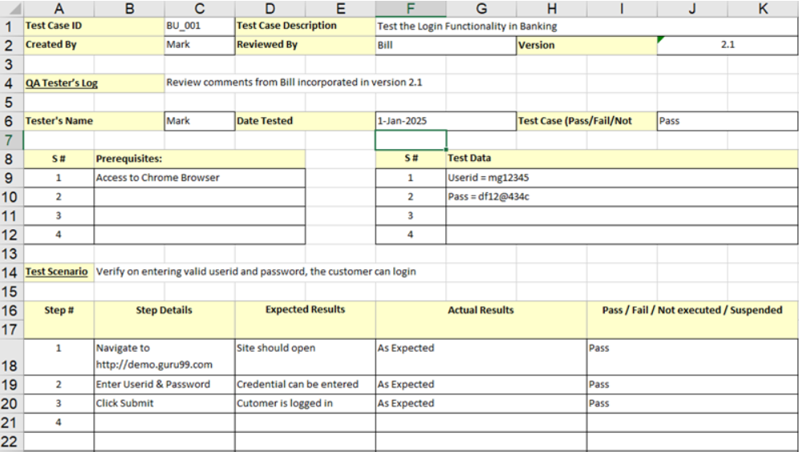
A Sample Test Case

Slide 16
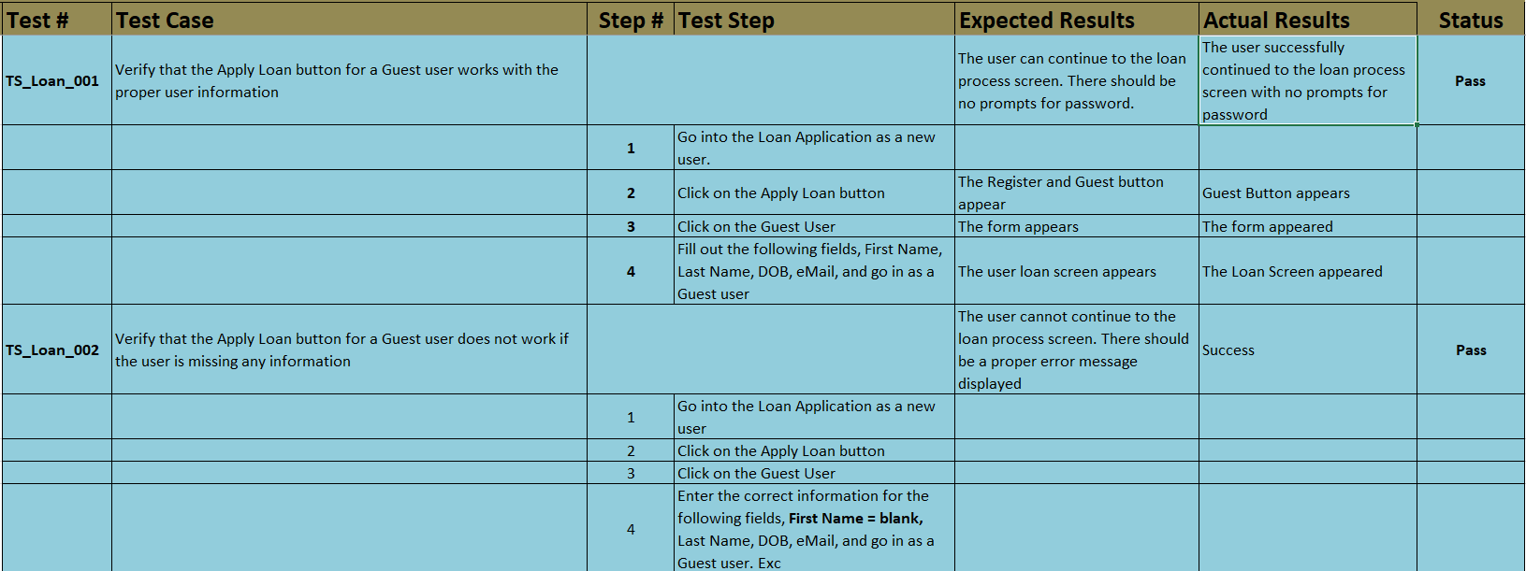
Loan Application Test Cases

Slide 17
Test Results and the testing artifacts
During testing screen shots may be captured and recorded.
During testing the database may have to get restored multiple times.
Test Stubs may have to be written to be able to execute more test cases.
Multiple rounds of regression testing may have to be performed.
Automation testing should be written to speed up the testing.
All test cases have to be in the test management system before execution.
Test reports should show the clear execution status. Passed, Failed, Executed.

